Slide 1

Government Engineering College, Gopalganj
A Project Report on
“QUIZ APP”
Team Member –
Gaurav Kumar Sharma(22154149010)
Mohit Kumar(22154149004)
Ritesh Kumar(22154149019)
Suruchi Kumari(22154149015)
Branch – CSE
Semester - 7th
Under the Guidance of:
Mr. Gaurav Kumar
Assistant Professor, CSE

Slide 2
Table of Content
Introduction
Project Overview
Objectives of the project
System Architecture
System Modules
Frontend Highlight
Backend API structure
Database Design(MongoDB)
Authentication Flow
Features of the app
Advantages of the system
Future Enhancement & Conclusion

Slide 3
Introduction
Traditional quiz systems are mostly manual and time-consuming.
Managing quizzes for many students is difficult.
Teachers need an efficient way to create and manage quizzes online.
Students require a platform where they can attempt quizzes easily.
Manual evaluation can cause errors and delays.
Solution: To develop an Online Quiz Application that allows admins to create quizzes and students to attempt them easily with automatic result generation.

Slide 4


Quiz App

Slide 5

Project Overview
Purpose: Online Quiz Platform for Admins & Students
Tech Stack:
Frontend: React, Vite, Material-UI
Backend: Node.js, Express
Database: MongoDB

Slide 6
Objectives of the Project
To develop a web-based quiz platform for students and administrators.
To provide a secure login and authentication system.
To allow admins to create, update, and delete quizzes.
To enable students to attempt quizzes online.
To automatically calculate scores and display results.
To store quiz data and results in a database.

Slide 7
System Architecture
Diagram:
Frontend (Vite/React) → Backend (Express) → MongoDB
Key Components:
Frontend: Quiz Editor, Dashboard, User Views
Backend: REST API, Auth Middleware
Database: Quiz, User, Result Models

Slide 8
System Modules The Quiz Application consists of two main modules:
1. Admin Module
Admin login authentication Student login and authentication
Create and manage quizzes
Edit and delete quiz questions
View student results and performance
2. Student Module
Student login and authentication
View available quizzes
Attempt quizzes
View scores and results

Slide 9
Frontend Highlight
Dynamic quiz interface with Material-UI
Responsive design (Grid/Flexbox)
Form validation & error handling

Slide 10
Backend API Structure
Endpoints:
POST /api/auth/login
GET /api/quiz
DELETE /api/admin/quiz/:id
Middleware:
JWT authentication
Role-based access (admin/student)

Slide 11
Database Design (MongoDB) The application uses MongoDB to store all data. Main Collections:
Users Collection
Quiz Collection
User ID
Name
Email
Password
Role (Admin / Student)
Results Collection
User ID
Quiz ID
Score
Attempt Date
Quiz ID
Quiz Title
Questions
Options
Correct Answer

Slide 12
Authentication Flow
JWT Implementation:
User login → Server generates token
Token stored (local Storage)
Subsequent requests include token in headers
Security: HTTPS, token expiration (5h)

Slide 13
Working Flow of the Application
User opens the Quiz Application.
User logs in using valid credentials.
System verifies authentication using JWT token.
User selects a quiz.
Quiz questions are displayed.
User selects answers and submits the quiz.
System automatically evaluates answers.
Final score is displayed.
Result is stored in the database.

Slide 14
Features of the App
User authentication
Admin Dashboard
Dynamic quiz Creation
Performance Graph
Real-time Leaderboard
Quiz Containing at least 10 Question.
Score tracking and result analytics

Slide 15
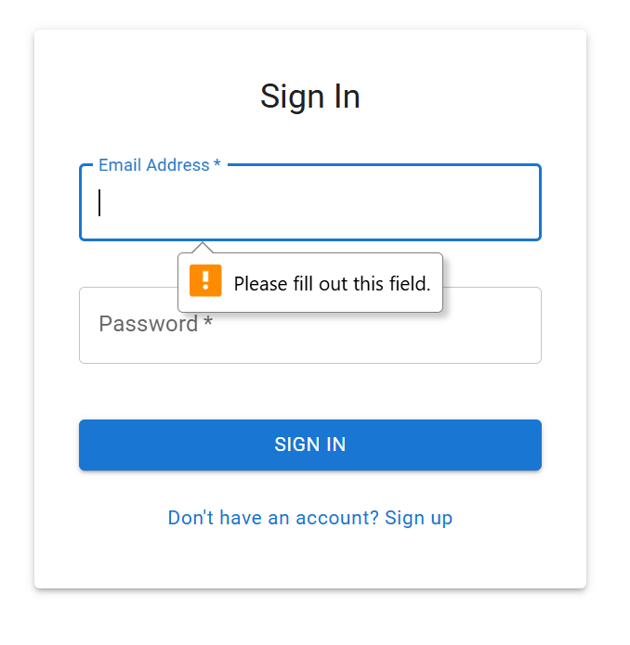
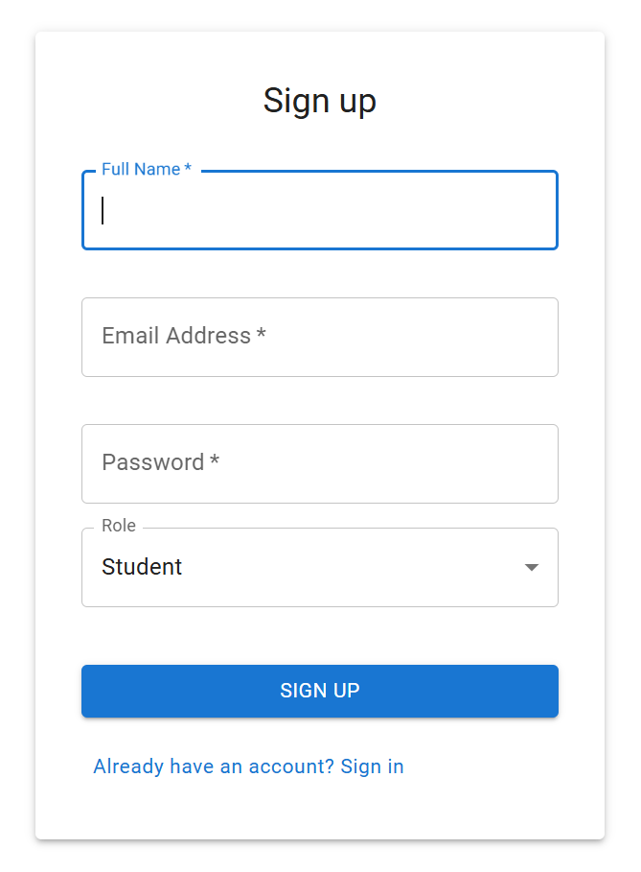
Key Features:
User authentication (JWT)

Slide 16
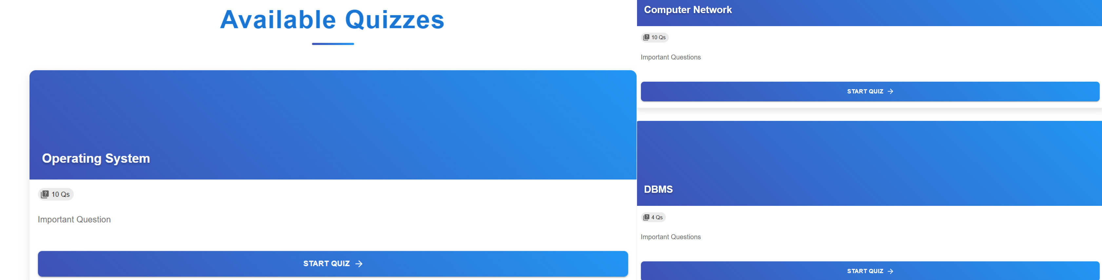
Key Features:

Slide 17
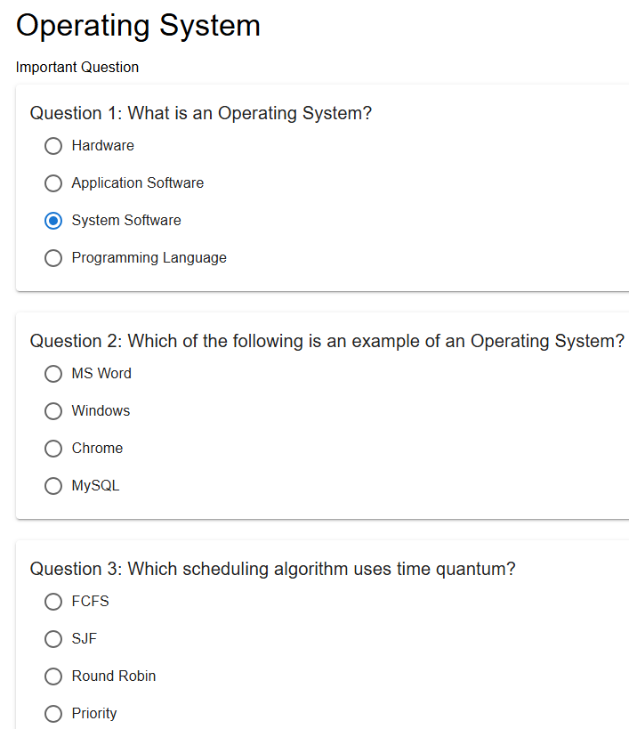
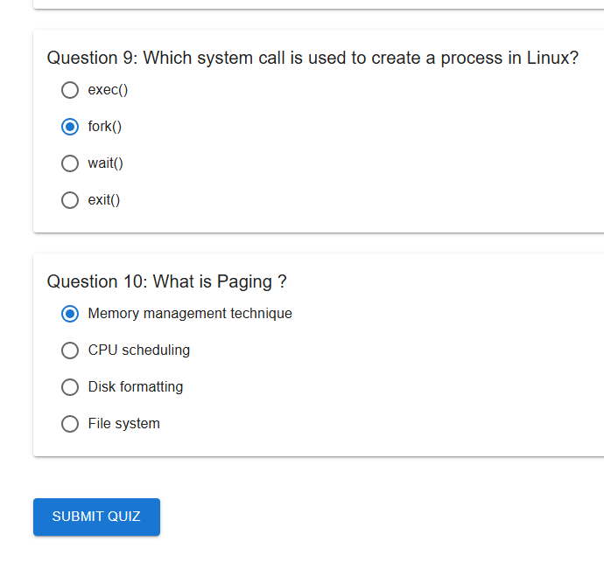
Question
Key Features:

Slide 18
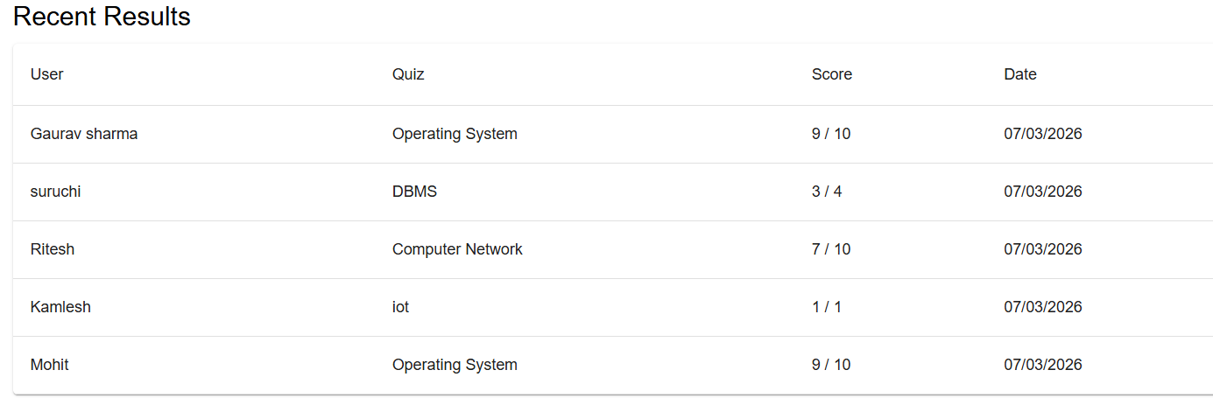
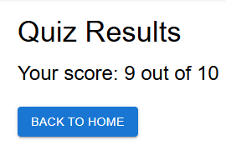
Results and History

Slide 19
Admin Features
Quiz Management:
Create/edit/delete quizzes
View results dashboard

Slide 20
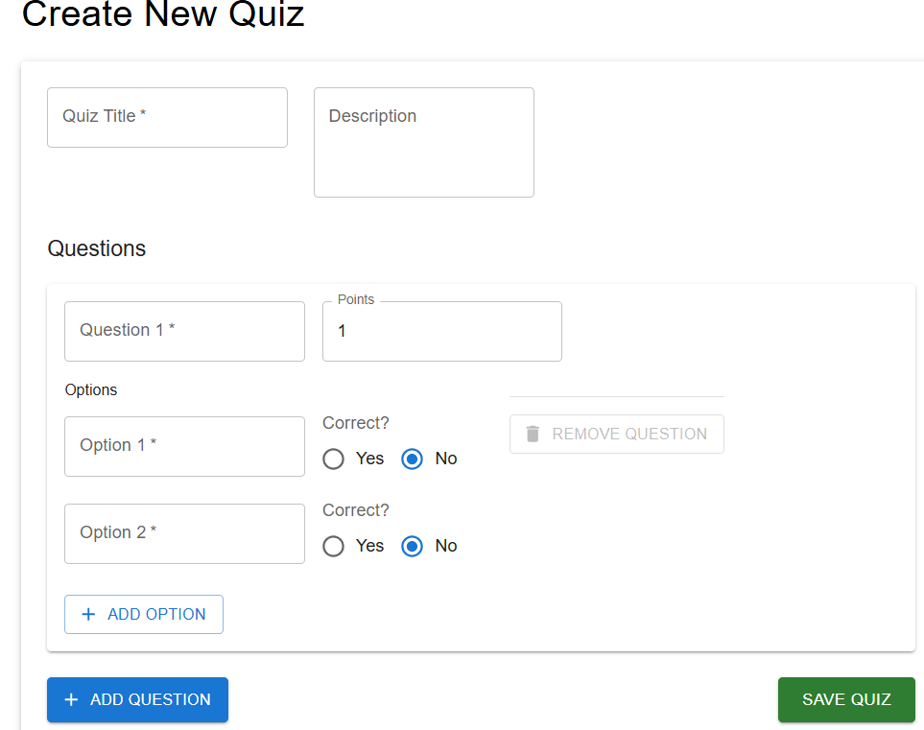
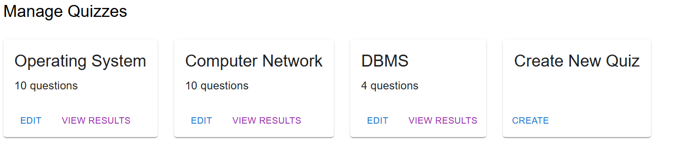
Key Features:
Quiz creation & management

Slide 21
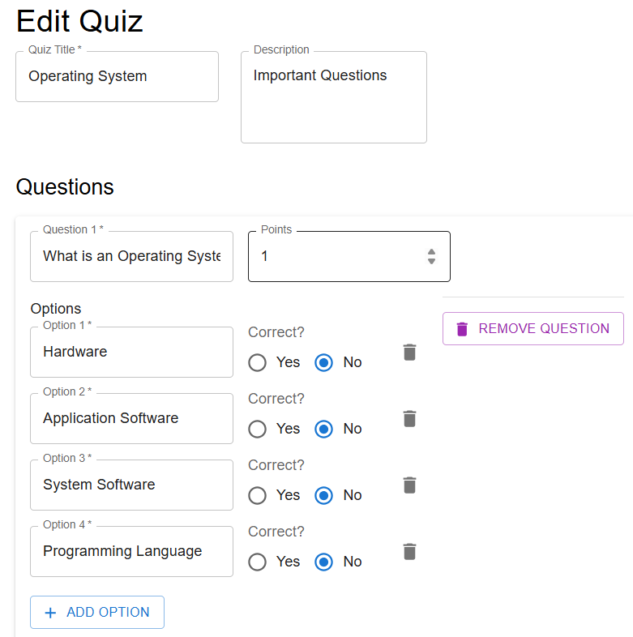
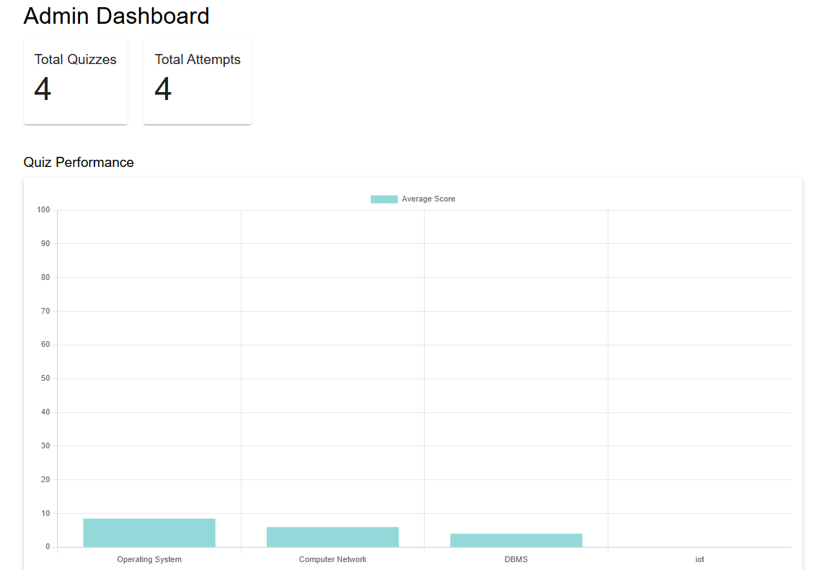
Admin Edit Quiz
Admin Dashboard

Slide 22
Admin Dashboard

Slide 23
Advantages of the System
Easy quiz creation and management.
Instant result generation.
User-friendly interface.
Reduces manual effort in quiz evaluation.
Centralized database for storing results.

Slide 24
Future Enhancements
Timer for quizzes
Question randomization
PDF report generation

Slide 25
Conclusion
The Quiz Application provides an efficient platform for conducting online quizzes.
It helps administrators manage quizzes easily and allows students to attempt quizzes and get instant results.
The system is built using modern technologies such as React, Node.js, Express, and MongoDB, making it scalable and secure.

Slide 26
Reference
ReactJS – https://reactjs.org/docs/getting-started.html
ExpressJS– https://expressjs.com/
MongoDB – https://www.mongodb.com/docs/
Node.js – https://nodejs.org/en/docs/

Slide 27


